Slide 1

Strike+OCA Escort
Range 23
Notes:
2020-03-09: Version 1.0

Slide 2
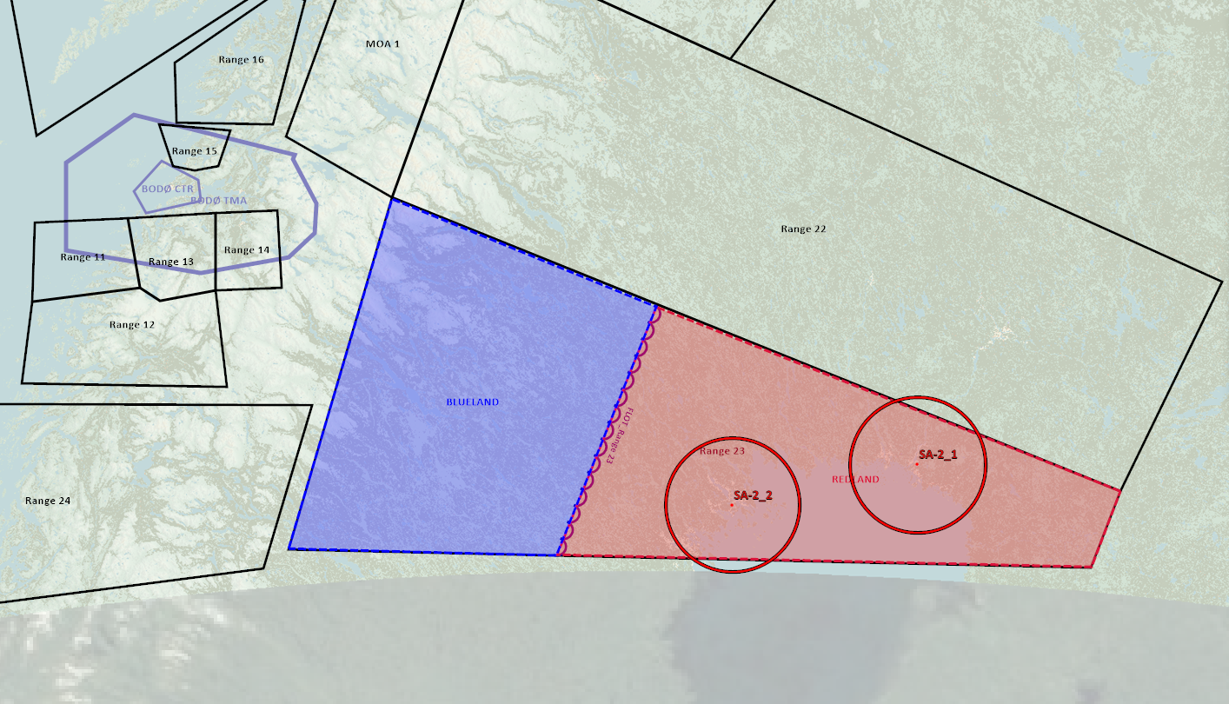
SITUATION
Scenario: REDLAND and BLUELAND at war. BLUELAND have picked up intelligence regarding a possible chemical weapon attack against BLUELAND using SCUDS. SCUDS are forward staged into covert military storage close to the border (FLOT)

Slide 3
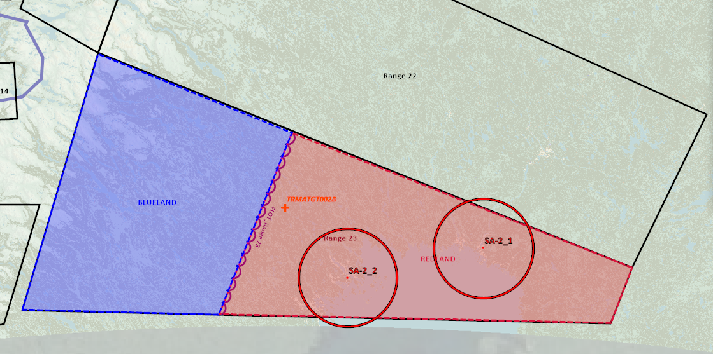
MISSION
Strike military storages
Task strike flight: Conduct strike
Task escort flight: Escort strike flight
Time On Target (TOT): Escort flight and Strike flight need to set a TOT for planning purposes.

Slide 4
Blue Commanders intent
BLUE MISSION:
Task: Strike REDLAND military storages
Purpose: Prevent REDLAND SCUDs to be used for chemical weapon attacks.
BLUE LOSSES NOT ALLOWED
RISK LEVEL: MEDIUM
TRAINING OBJECTIVES:
-Objective 1: OCA Escort Mission - Objective 2: Communication between flights (Strike + Escort) - Objective 3: Mission planning and flight briefing - Objective 4: BVR timeline - Objective 5: ROE - Objective 6: Commit criteria(s) - Objective 7: Flightlead and wingman practice

Slide 5
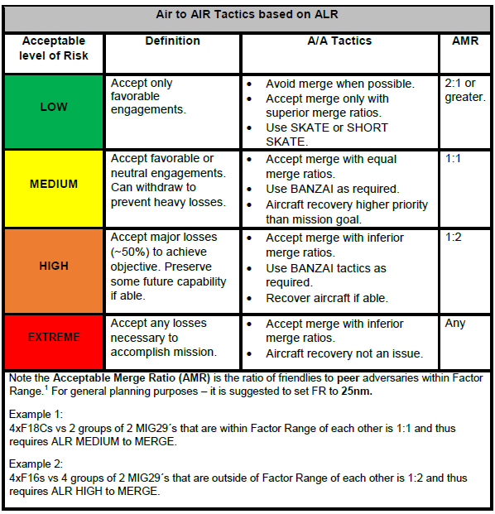
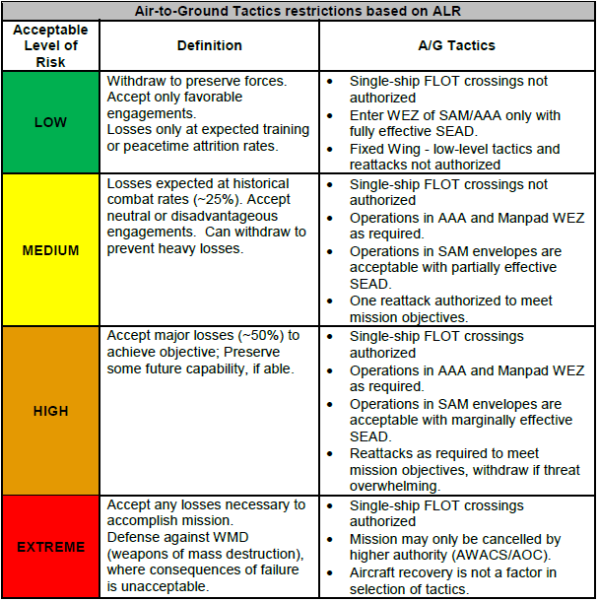
Blue ALR

Slide 6
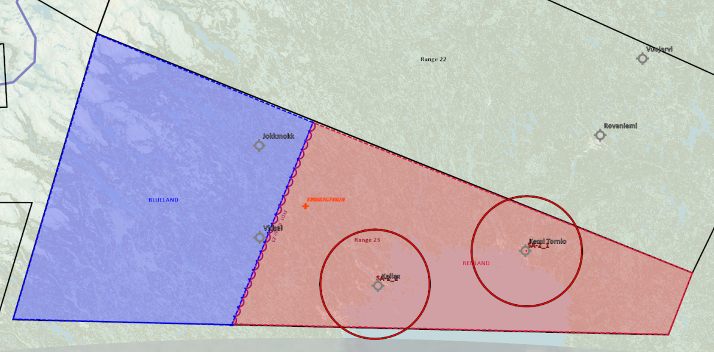
THREATS
SAM THREATs: SA-2s are protecting REDLAND airfields KALLAX and KEMI TORNIO. In addition SA-11 and SA-6 are mobile threats likely operating in REDLAND territory.
REDLAND Airforce consist of 3 squadrons:
Squadron 1: F-16
Squadron 2: F/A-18
Squadron 3: F-14
These squadrons are normally rotating through KALLAX and KEMI TORNIO.
These 3 squadrons normally rotate on DCA (Defensive Counter Air) duties. Normal modus of operandi is to have one flight airborne as a CAP, or on ground alert as a QRA with a 5 minute alert. Normally one additional flight is on backup as QRA 15 minute alert.
- REDLAND jets have routinely violated BLUELAND airspace and established CAP on BLUELAND side of border

Slide 7
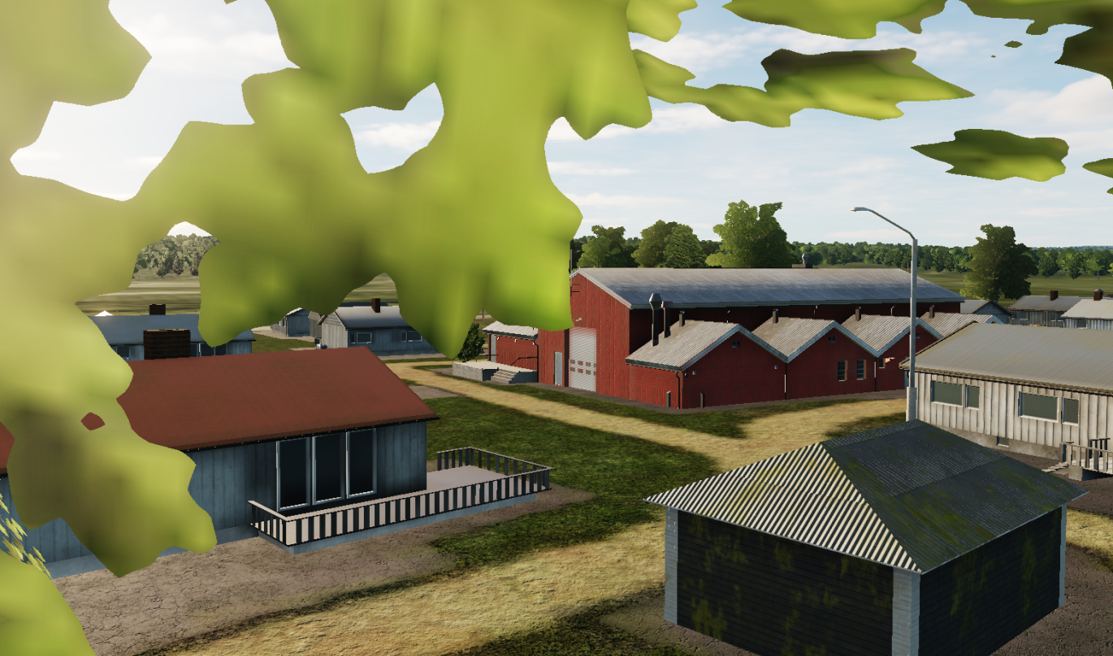
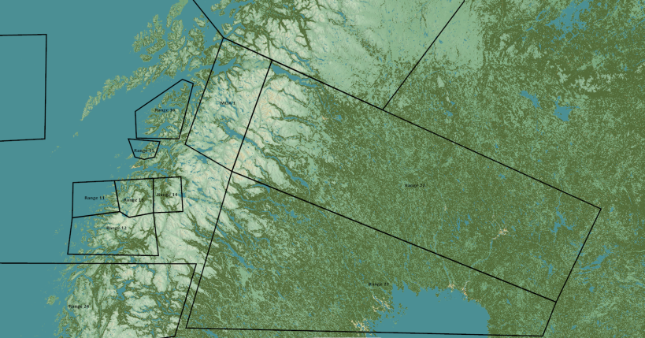
TRMATGT002 Military Storage
N
TRMATG002B
2A
002
DESCRIPTION OF THE DESIRED POINTS OF IMPACT WITH WPN TYPE:
TRMATGT002A – Military Storage
DPI 1: N66 05.241 E020 54.175 / Elevation: 61ft
Weaponeering:
2x 500Ibs bomb or 1x 1000Ibs bomb.
Due to collateral damage risk surrounding target PGM is needed.
TRMATGT002 Military storage is a covert storage facility for REDLAND SCUDs that are part of the chemical weapon program. The SCUD launchers are prepared to load warheads with chemical weapons.
Target 2A and 2B must be attacked at the same time due to risk of enemy withdrawing high value targets within the military storage.

Slide 8
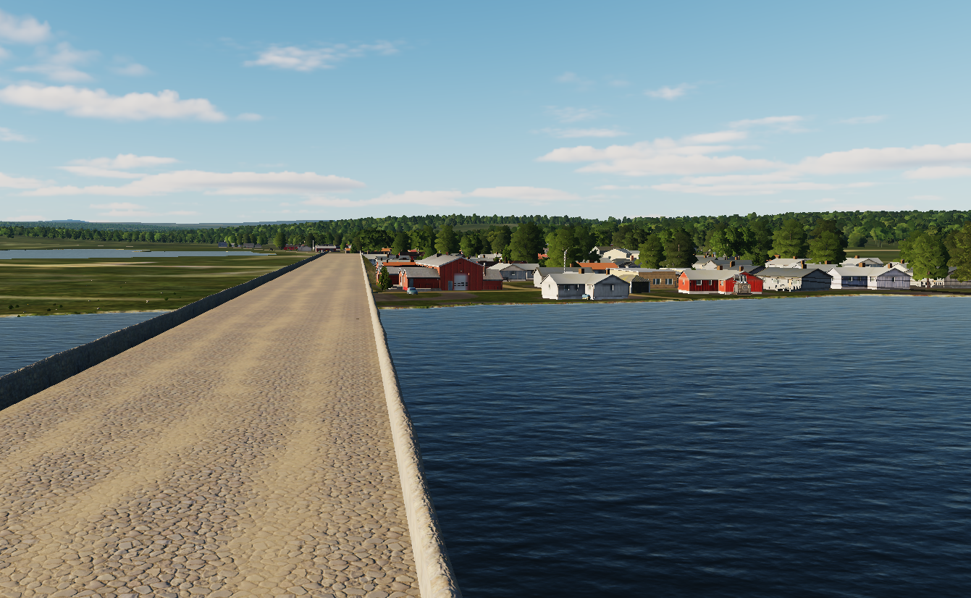
TRMATGT002 Military Storage
N
TRMATG002A
002
2B
DESCRIPTION OF THE DESIRED POINTS OF IMPACT WITH WPN TYPE:
TRMATGT002B – Military Storage
DPI 1: N66 05.460 E020 55.133/ Elevation: 52ft
Weaponeering:
2x 500Ibs bomb or 1x 1000Ibs bomb.
Due to collateral damage risk surrounding target PGM is needed.
TRMATGT002 Military storage is a covert storage facility for REDLAND SCUDs that are part of the chemical weapon program. The SCUD launchers are prepared to load warheads with chemical weapons.
Target 2A and 2B must be attacked at the same time due to risk of enemy withdrawing high value targets within the military storage.

Slide 9
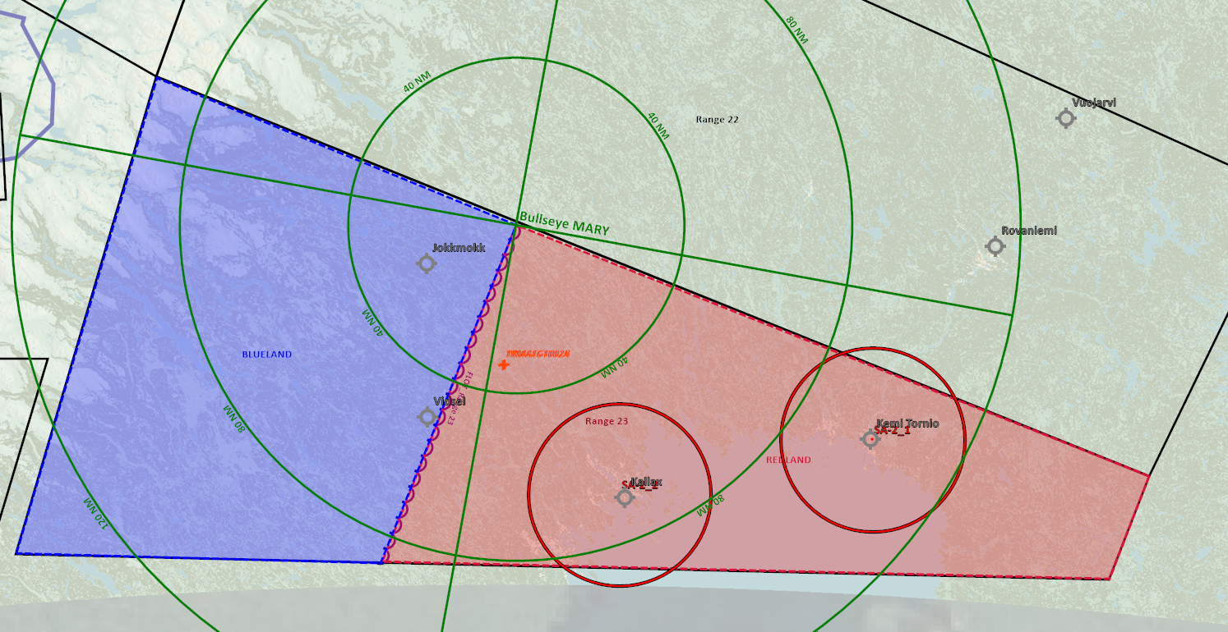
BULLSEYE
Same for both BLUE and RED

Slide 10
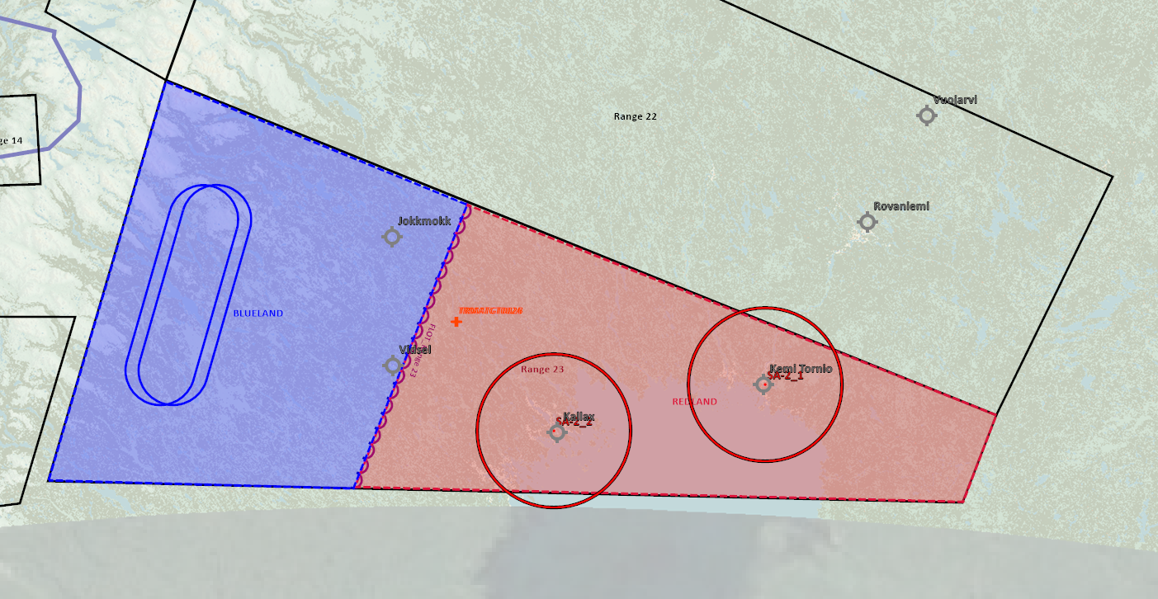
AAR Support
BLUE: AR202 (F-16) AR302 (F-14, F/A-18)
RED: Tankers available on request in range 22, but not needed for scenario
Tankers need to be activated via F10 menu manually (Blue will activate BLUE tanker, Red will activate RED tanker)

Slide 11
Flow and admin
This mission is conducted in the following way:
Blue force plan according this this brief.
Red force (aggressor conduct own plan in according to Red Commanders intent, to facilitate and meet Blue force training objectives.)
Flight announces killed by announcing on Safety&Kill freq (or AWACS freq if AWACS is supporting) & by squawking IFF 4000
Once killed, RED (aggressor) aircraft will spiral and dive down toward the ground and flow to reset area.
BLUE will continue regardless of beeing it. Red aggressors will land/touch-and-go at Reset airfield, and can get airborne again immediately to get back in the fight. (If AWACS is supporting BLUE, then AWACS can respawn red aggressors outside reset points at AWACS discretion).
Flights observes kills by missile script information
RESET BLUE: N/A – Continue mission and debrief hits after event
RESET RED: Kallax airbase
HARD DECK: N/A
IF AWACS is supporting RED side: (BLUE AWACS on by default)
RED AWACS need to be activated using F10 menu (WIZARD)

Slide 12
Command & Control
IF AWACS:
If 1 AWACS controller, AWACS will support Blue package
Safety & Kill frequency: 242.0 (Range 23 primary freq) (monitored by AWACS + aggressors)
Tactical freq: (Blue package+AWACS) 226.5 (Tactical frequency 1)
AWACS controls RED/BLUE on tactical freq and coordinate with the other side for event start and kills on Safety & Kill freq.
IF NOT AWACS:
- Package frequency (BLUE): 242.0 (Range 23 primary freq)
Safety & Kill frequency: Range 23 primary (242.0) (Aggressors monitor package and announce kills/safety/coordination only)
All kills announced on S&K freq

Slide 13
Red Commanders intent
MISSION: DEFEND RED TERRITORY FROM BLUE INTRUSION
RED LOSSES ALLOWED
RISK LEVEL: HIGH
TRAINING OBJECTIVES:
- Objective 1: DCA CAP mission - Objective 2: Practice Grinder tactics (Counter Rotating CAP) - Objective 3: Good SA on potential threats - Objective 4: Timeline for engagement - Objective 5: Communications within the flight - Objective 6: Missile defence - Objective 7: Mission planning and flight briefing - Objective 8: Flight lead and wingman training

Slide 14
Red ALR

